Slide 2
Driver Annotations in Depth
Part I
Donn Terry
Senior SDE
Static Analysis for Drivers
sdvpfdex@microsoft.com

Slide 3

Introduction
Two hour talk – effective use of annotations.
Part 1:
  Motivation, general techniques
  Buffer annotations
  Structural annotations: __success, __on_failure, __drv_when,
  __drv_at, __valid, __pre and __post __deref, __drv_valueIs
Part 2 (Next hour)
  Driver annotations: additional checks, resources, IRQLs, PAGED_CODE, floating point.
Talk Objectives
Intuition on what annotations are and why use them
General explanation of common/typical annotations
“Introduce” the documentation
Breadth, not depth.

Slide 4
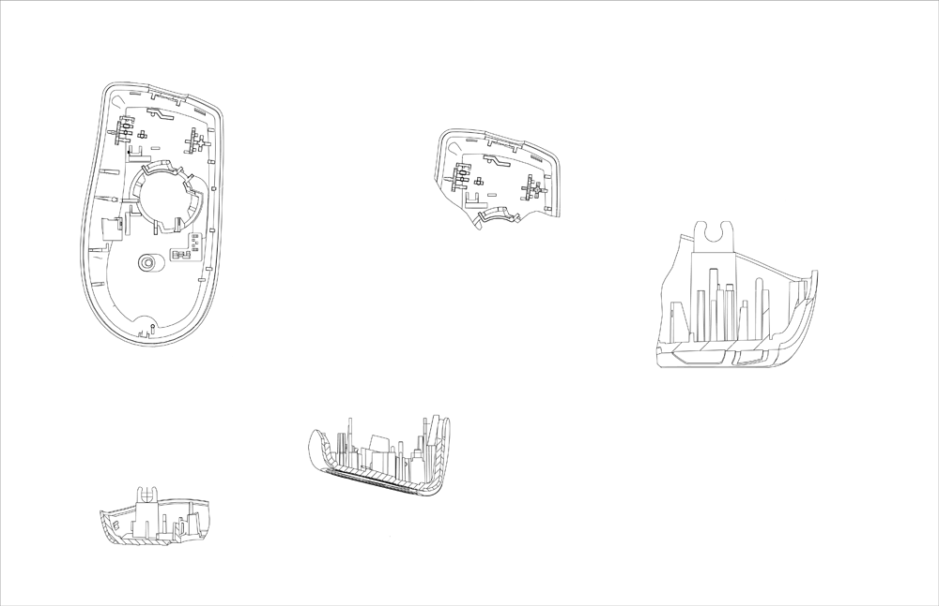

Slide 5
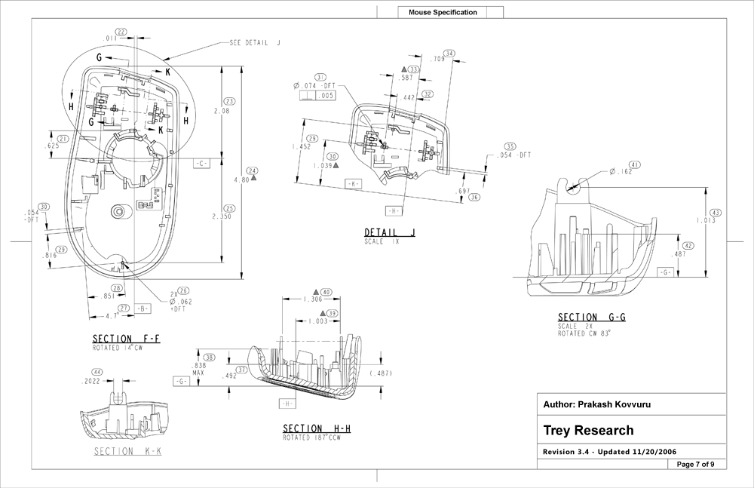

Slide 6
Why Annotate?
Good engineering practice
Enables “Design Rule Checking,” also known as “Static Analysis”
Precisely describe the “part” you’re building and the contract that it represents
Enable automatic checking
Effective (and checked) documentation
  You don’t have to guess or experiment
  Code and documentation don’t drift apart
Speed driver development
  Fewer false starts
  Fewer turn-on bugs
Faster deployment
  Fewer as-deployed bugs

Slide 7
Applicability
Annotate as early as possible (as part of design)
  Catch-up is still very useful
Run PFD as soon as the code begins to compile
x86, x64
C/C++
Any kind of driver
  Applets, too, with right annotations.

Slide 8
Assumptions
You know what __in, __out, and _opt are.
You know about function typedefs/role types.
If you missed that, review Session 690.
Everyone here is an expert programmer, and this shouldn’t be hard for experts.
But it is new; there’s some learning and “getting used to” to do.
Plenty of reference material – see it for details.

Slide 9
Annotation Design
Enable effective use of the interfaces
Describe what is required for success
Concisely express the semantics to users
Help the tool analyze for improper use or unintended consequences
Recommend more effective alternatives
Suppress noise

Slide 10
Tip
Annotate for the Success Case
You want a function call that will never succeed to be caught statically
  “Optional” means it will do something useful if the parameter is absent
  Checking for null and returning an error is good defensive coding practice, but doesn’t make the parameter optional
  The same general idea applies to other annotations we’ll see later

Slide 11
ExAllocatePool
What does it do?

Slide 12
NTKERNELAPI
PVOID
ExAllocatePool(
__in POOL_TYPE PoolType,
__in SIZE_T NumberOfBytes
);

Slide 13
__drv_allocatesMem(Mem)
NTKERNELAPI
PVOID
ExAllocatePool(
__in POOL_TYPE PoolType,
__in SIZE_T NumberOfBytes
);

Slide 14
__drv_allocatesMem(Mem)
__bcount(NumberOfBytes)
NTKERNELAPI
PVOID
ExAllocatePool(
__in POOL_TYPE PoolType,
__in SIZE_T NumberOfBytes
);

Slide 15
__drv_allocatesMem(Mem)
__post __maybenull
__bcount(NumberOfBytes)
NTKERNELAPI
PVOID
ExAllocatePool(
__in POOL_TYPE PoolType,
__in SIZE_T NumberOfBytes
);

Slide 16
__drv_allocatesMem(Mem)
__post __maybenull __checkReturn
__bcount(NumberOfBytes)
NTKERNELAPI
PVOID
ExAllocatePool(
__in POOL_TYPE PoolType,
__in SIZE_T NumberOfBytes
);

Slide 17
__drv_allocatesMem(Mem)
__drv_when(((PoolType&( POOL_RAISE_IF_ALLOCATION_FAILURE)))==0,
__post __maybenull __checkReturn)
__bcount(NumberOfBytes)
NTKERNELAPI
PVOID
ExAllocatePool(
__in POOL_TYPE PoolType,
__in SIZE_T NumberOfBytes
);

Slide 18
__drv_allocatesMem(Mem)
__drv_when(((PoolType&( POOL_RAISE_IF_ALLOCATION_FAILURE)))==0,
__post __maybenull __checkReturn)
__drv_when(((PoolType&( POOL_RAISE_IF_ALLOCATION_FAILURE)))!=0,
__post __notnull)
__bcount(NumberOfBytes)
NTKERNELAPI
PVOID
ExAllocatePool(
__in POOL_TYPE PoolType,
__in SIZE_T NumberOfBytes
);

Slide 19
__drv_allocatesMem(Mem)
__drv_when(((PoolType&( POOL_RAISE_IF_ALLOCATION_FAILURE)))==0,
__post __maybenull __checkReturn)
__drv_when(((PoolType&( POOL_RAISE_IF_ALLOCATION_FAILURE)))!=0,
__post __notnull)
__bcount(NumberOfBytes)
NTKERNELAPI
PVOID
ExAllocatePool(
__drv_strictTypeMatch(__drv_typeExpr) __in POOL_TYPE PoolType,
__in SIZE_T NumberOfBytes
);

Slide 20
__drv_allocatesMem(Mem)
__drv_when(((PoolType&0x1))!=0, __drv_maxIRQL(APC_LEVEL))
__drv_when(((PoolType&0x1))==0, __drv_maxIRQL(DISPATCH_LEVEL))
__drv_when(((PoolType&( POOL_RAISE_IF_ALLOCATION_FAILURE)))==0,
__post __maybenull __checkReturn)
__drv_when(((PoolType&( POOL_RAISE_IF_ALLOCATION_FAILURE)))!=0,
__post __notnull)
__bcount(NumberOfBytes)
NTKERNELAPI
PVOID
ExAllocatePool(
__drv_strictTypeMatch(__drv_typeExpr) __in POOL_TYPE PoolType,
__in SIZE_T NumberOfBytes
);

Slide 21
__drv_allocatesMem(Mem)
__drv_when(((PoolType&0x1))!=0, __drv_maxIRQL(APC_LEVEL))
__drv_when(((PoolType&0x1))==0, __drv_maxIRQL(DISPATCH_LEVEL))
__drv_when(((PoolType&0x2))!=0,
__drv_reportError("Must succeed pool allocations are forbidden. "
"Allocation failures cause a system crash"))
__drv_when(((PoolType&( POOL_RAISE_IF_ALLOCATION_FAILURE)))==0,
__post __maybenull __checkReturn)
__drv_when(((PoolType&( POOL_RAISE_IF_ALLOCATION_FAILURE)))!=0,
__post __notnull)
__bcount(NumberOfBytes)
NTKERNELAPI
PVOID
ExAllocatePool(
__drv_strictTypeMatch(__drv_typeExpr) __in POOL_TYPE PoolType,
__in SIZE_T NumberOfBytes
);

Slide 22
__drv_allocatesMem(Mem)
__drv_when(((PoolType&0x1))!=0, __drv_maxIRQL(APC_LEVEL))
__drv_when(((PoolType&0x1))==0, __drv_maxIRQL(DISPATCH_LEVEL))
__drv_when(((PoolType&0x2))!=0,
__drv_reportError("Must succeed pool allocations are forbidden. "
"Allocation failures cause a system crash"))
__drv_when(((PoolType&(0x2|POOL_RAISE_IF_ALLOCATION_FAILURE)))==0,
__post __maybenull __checkReturn)
__drv_when(((PoolType&(0x2|POOL_RAISE_IF_ALLOCATION_FAILURE)))!=0,
__post __notnull)
__bcount(NumberOfBytes)
NTKERNELAPI
PVOID
ExAllocatePool(
__drv_strictTypeMatch(__drv_typeExpr) __in POOL_TYPE PoolType,
__in SIZE_T NumberOfBytes
);

Slide 23
__drv_preferredFunction("ExAllocatePoolWithTag",
"No tag interferes with debugging.")
__drv_allocatesMem(Mem)
__drv_when(((PoolType&0x1))!=0, __drv_maxIRQL(APC_LEVEL))
__drv_when(((PoolType&0x1))==0, __drv_maxIRQL(DISPATCH_LEVEL))
__drv_when(((PoolType&0x2))!=0,
__drv_reportError("Must succeed pool allocations are forbidden. "
"Allocation failures cause a system crash"))
__drv_when(((PoolType&(0x2|POOL_RAISE_IF_ALLOCATION_FAILURE)))==0,
__post __maybenull __checkReturn)
__drv_when(((PoolType&(0x2|POOL_RAISE_IF_ALLOCATION_FAILURE)))!=0,
__post __notnull)
__bcount(NumberOfBytes)
NTKERNELAPI
PVOID
ExAllocatePool(
__drv_strictTypeMatch(__drv_typeExpr) __in POOL_TYPE PoolType,
__in SIZE_T NumberOfBytes
);

Slide 24
Problem
Buffer overruns
Buffer overruns are always a risk
  Reliability
  Security
PFD can check that the size you expect is the size you used
You can specify the size in bytes or elements
PFD finds:
  Buffer isn’t as big as the size (caller and callee)
  Running off end (or beginning) of buffer
  No information or unhelpful information about size

Slide 25
Buffer Annotations
_bcount: where to find the size, in bytes.
_ecount: where to find the size, in elements
_part, _full: is all the buffer used (and how much)
Compose into single tokens like __deref_inout_ecount_part(size,length)

Slide 26
Example
Buffer annotations
NTKERNELAPI
PIRP
IoBuildDeviceIoControlRequest(
__in ULONG IoControlCode,
__in PDEVICE_OBJECT DeviceObject,
__in_opt_bcount(InputBufferLength) PVOID InputBuffer,
__in ULONG InputBufferLength,
__out_opt_bcount(OutputBufferLength) PVOID OutputBuffer,
__in ULONG OutputBufferLength,
__in BOOLEAN InternalDeviceIoControl,
__in PKEVENT Event,
__out PIO_STATUS_BLOCK IoStatusBlock
);
Fewer buffer overruns

Slide 27
Problem
Ignoring errors
Some functions can fail, but it’s easy to forget to check. PFD can remind you
Use on functions that return NULL when they fail. Reminds you to test the result (avoid bluescreens).
__checkReturn
NTSTATUS
KeSaveFloatingPointState(
__out PKFLOATING_SAVE FloatSave
);
Never forget to check for success again

Slide 28
Implied Annotations
Smarter Types
typedefs can be annotated
The annotation applies to objects of that type
Contrast with this:
The first is a simple buffer, the second is a C String. The difference is the annotation.
More than just “saving typing,” it documents intent and allows PFD to check that the intent is fulfilled.
typedef wchar_t *LPWCH;
typedef __nullterminated wchar_t *LPWSTR;

Slide 29
‘Structural’ Annotations
“How” the annotations apply
Describe when and where an annotation applies; apply to “functional” annotations
  __success, __failure, __on_failure, __failure_default
  __drv_when
  __drv_at
  __pre, __post -> __drv_in(), __drv_out()
  __valid
Composable (they nest)

Slide 30
__success
When interfaces can fail
  typedef __success(return >= 0) LONG NTSTATUS;
__success(<expression>) tells PFD that the contract will not be met if the expression is false.
  Built in to NTSTATUS (and HRESULT)
Most system interfaces can then succeed or fail (meet contract or not).
  Generally the right answer, but there are exceptions.

Slide 31
__success
When the function never fails
  __success(TRUE) NTSTATUS IoCallDriver(…
Function always succeeds, return value is NTSTATUS, but just as information:
  IoCallDriver returns the status from a lower level in the stack. It always succeeds.

Slide 32
__on_failure
Contract when failure
Sometimes the failure path does something useful:
  …
  NTKERNELAPI
  NTSTATUS
  IoCreateDevice(
  …
  __drv_out_deref(
  __drv_allocatesMem(Mem) __drv_valueIs(!=0)
  __on_failure(__null) )
  PDEVICE_OBJECT *DeviceObject
  );

Slide 33
__failure
Defining “failure”
__success defines what return values cause the contract to be met.
PFD assumes all others are failure (contract not met)
  But sometimes code (unconsciously) assumes that other values are impossible, and “impossible” values yield noise
__failure(expression) says what values are considered failure
  All others are impossible and won’t cause noise (are not analyzed).
    typedef __success(return == 0)__failure(return < 0) LONG MYSTATUS;

Slide 34
__on_failure
Undefined Results
When a function fails, it’s often unsafe to look at the results.
  Don’t look at this value on the failure path:
  Don’t look at any output if the function fails:
PFD will report using an uninitialized variable.
__on_failure(__valueUndefined)
__failureDefault(__failureUndefined)

Slide 35
__drv_when(condition, annotations)
Conditional operator
__drv_when(<condition>, <annotation> <annotation>…)
“Guards”, not quite “if”
Group automatically
Condition can be static or “simulation time”
Side-effect-free C/C++ expression:
  + - * / % & | && || < > == != <= >= << >> ^ ( ) -> . [] *
  Operands:
    Parameter names, ‘this’, ‘return’, __param(n), variables, field names
    Constants, C++ consts, enums (some symbol limitations in C++)
    (static) casts, sizeof
  A few functions: inFunctionClass$, macroValue$, macroDefined$, strstr$

Slide 36
__drv_when(condition, annotations)
Uses
__drv_when(((PoolType&(0x2|POOL_RAISE_IF_ALLOCATION_FAILURE)))==0,
__post __maybenull __checkReturn)
__drv_when(NTDDI_VERSION >= NTDDI_WINXP,
__drv_preferredFunction("IoVolumeDeviceToDosName",
"Obsolete on WINXP and above"))
__drv_maxIRQL(PASSIVE_LEVEL)
NTSYSAPI
NTSTATUS
NTAPI
RtlVolumeDeviceToDosName(
__in PVOID VolumeDeviceObject,
__out PUNICODE_STRING DosName
);

Slide 37
__drv_at(target, annotations)
Placement operator
__drv_at(<expression>, <annotation> <annotation>…)
Annotate complex operands
Annotate invisible objects: ‘this’
Annotate difficult cases more readably
__drv_at(this, __drv_freesMem(Mem)) void Release(void);
The target:
Same syntactic rules as __drv_when (side-effect free C/C++ expression)
Must yield an l-value at compile time

Slide 38
__drv_at(target, annotations)
Examples
__drv_at(pUnicodeString->Buffer, __nullterminated)
The following annotation can go anywhere on the function. In particular it can come before the function name in the ‘return’ position.
drv_when(pBuffer!=0 && cjBufferSize!=0,
__drv_at(return, __drv_valueIs(==0;==1))
__drv_when(return==1,
__drv_at(return, __drv_floatSaved)
__drv_at(pBuffer, __bcount_opt(cjBufferSize)
__drv_acquiresResource(EngFloatState))
(I’m not saying this is a good interface design!)

Slide 39
__valid
The object being annotated has a ‘well-formed’ value.
The definition/expression of ‘well-formed’ is evolving, but it always means at least initialized.
__in and __out include __valid
  But when does __valid apply in a function call? Before or after?
  It depends on what you care about.

Slide 40
__pre and __post
Semantics
__in -> __pre __valid (etc.)
__out -> __post __valid (etc.)
Caller/callee distinction here:
  Caller promises that the inputs will be valid.
  Callee assumes that the inputs are valid.
  Callee promises that the outputs will be valid (on success)
  Caller assumes that the outputs are valid (on success)
Many annotations obviously only pre or post
Some annotations apply in both cases
  Use __pre and __post where that’s an issue.

Slide 41
__pre and __post
Placement
Unary operators that apply only to the next (one) real annotation.
Parameters are by default ‘__pre’ (and value parameters have to be). (Consider ‘this’ a parameter).
‘return’ is always ‘post’.
Using __pre is actually rare except for explicitness.

Slide 42
__drv_in() and __drv_out()
__pre/__post are operators: scoping is sometimes “unexpected”
__drv_in and __drv_out do the same thing, but with appropriate scoping inside the ()s
These are safer, but pre/post are more fundamental concepts.

Slide 43
__deref
Equivalent to
  __drv_at(*<current param>,…)
Unary operator applies to only next annotation.
Somewhat archaic.
Used heavily in existing macros:
  __drv_in_deref() and __drv_out_deref()
void fun (__deref __deref __notnull long **p);
void fun (__drv_at(**p, __notnull) long **p);
These are the same annotation.

Slide 44
__drv_valueIs(<list>)
Specify possible result values.
Takes “;” separated list of partial expressions:
== <const expr> ; <= <cost expr>; etc.
__checkReturn
__drv_minIRQL(DISPATCH_LEVEL)
__drv_valueIs(==1;==0)
NTKERNELAPI
BOOLEAN
FASTCALL
KeTryToAcquireSpinLockAtDpcLevel (
__inout __deref __drv_neverHold(SpinLock)
__drv_when(return!=0, __deref __drv_acquiresResource(SpinLock))
PKSPIN_LOCK SpinLock
);

Slide 45
To be continued next hour
Driver Annotations additional checks, resources, IRQLs, PAGED_CODE, floating point.

Slide 46
Additional Resources
Web resources
    WHDC Web site
    PREfast step-by-step
    http://www.microsoft.com/whdc/DevTools/tools/PREfast_steps.mspx
    PREfast annotations
    http://www.microsoft.com/whdc/DevTools/tools/annotations.mspx
    How to Use Function typedefs in C++ Driver Code to Improve PREƒast Results
    http://go.microsoft.com/fwlink/?LinkId=87238
  Blog: http://blogs.msdn.com/staticdrivertools/default.aspx
  WDK documentation on MSDN
    PREfast for Drivers
    http://msdn.microsoft.com/en-us/library/aa468782.aspx
Chapter 23 in Developing Drivers with the Windows Driver Foundation
  http://www.microsoft.com/MSPress/books/10512.aspx
E-mail sdvpfdex @ microsoft.com

Slide 47
Related Sessions
Session | Day / Time
Using Static Analysis Tools When Developing Drivers | Mon. 8:30-9:30
Driver Annotations in Depth: Part 2 | Mon. 2:45-3:45
Lab: PREfast for Drivers | Mon. 11-12 and Wed. 8:30-9:30
Lab: Static Driver Verifier for WDM, KMDF, and NDIS | Mon. 5:15-6:15 and Wed. 11-12
Integrating PREfast into Your Build by Using Microsoft Auto Code Review | Tues. 4-5
Using Static Driver Verifier to Analyze KMDF Drivers | Mon. 4-5
Using Static Driver Verifier to Analyze NDIS Drivers | Tues. 9:45-10:45
Using Static Driver Verifier to Analyze Windows Driver Model Drivers | Wed. 9:45-10:45

Slide 48
Questions?

